Slide 1

NBA Players Salary Projection
王瀚 徐躍華 林資超 徐子崴

Slide 2
Outline
Commercial Value
Web Crawler and Data Preprocessing
Data Analysis and Visualization
Modeling
System Demo
Future Prospects
NBA Players Salary Projection
王瀚 徐躍華 林資超 徐子崴

Slide 3
Commercial Value
球員對於球隊的價值
花多少錢簽下這個球員才是划算的？

Slide 4
Commercial Value

Slide 5
Web Crawler and Data Preprocessing
爬蟲取得資料
資料前處理

Slide 6
Web Crawler and Data Preprocessing
2364
*Player’s stats & salary during 2011 - 2017
爬蟲取得資料
資料前處理

Slide 7
Web Crawler and Data Preprocessing
爬蟲取得資料
資料前處理
將不同的資料（基本數據、進階數據、薪資）根據球員名稱整合為一份。
改為西元 x 年的數據配上西元 x+1 年的薪水
整合一年內曾轉隊的球員資料成一筆

Slide 8
Web Crawler and Data Preprocessing
爬蟲取得資料
資料前處理
清理資料欄位
將Position原先資料的SG, PG, SF, PF, C整合成C, F, G三個位置
新增去年的薪水欄位
新增其他進階數據 (EFF, GmSc)

Slide 9
Visualization and Data Analysis

Slide 11
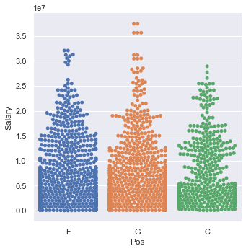
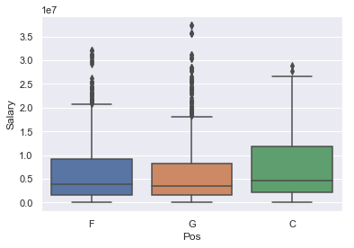
Visualization

Slide 12
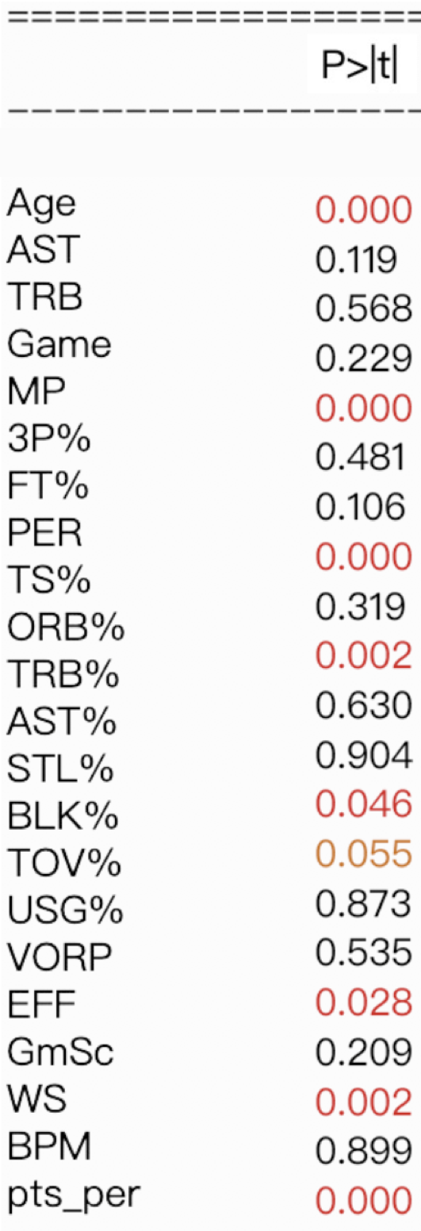
Data Analysis
OLS(Ordinary Least Squares) for Multiple Regression Analysis
p-value <= 0.05

Slide 13
Data Analysis
OLS(Ordinary Least Squares) for Multiple Regression Analysis
p-value <= 0.05

Slide 14
OLS(Ordinary Least Squares) for Multiple Regression Analysis
p-value <= 0.05

Slide 15
Modeling

Slide 16
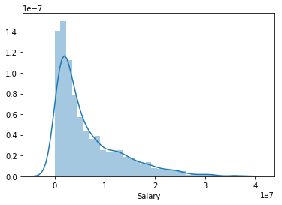
Modeling
Choosing error metric
Looks like a log-normal dist.
Scenario:
is 1M error equaly "off" at 2M level and 20M level?
Salary Distribution

Slide 17
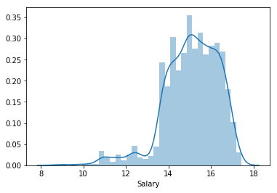
Modeling
Choosing error metric
Error metric:
RMSE of ln(ground truth) and ln(prediction)
* Probably makes more accurate estimations for low-salary players
Salary Distribution
(After log-transformation)

Slide 18
Modeling
Train/Test split

Slide 19
Modeling
First try
Solution: Repeated random sub-sampling validation (Monte Carlo cross-validation)
-> mitigate the noises caused by train/test split
Our data set is small, and salaries are not totally depends on performance. (for example, popularity of the player may affect his salary) -> many outliers
Different train/test split may favors different model, and the noise it cause is much higher than models' performance difference

Slide 20
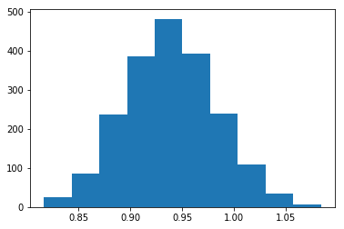
Modeling
Linear regression
RMSE dist.
Mean = 0.939

Slide 21
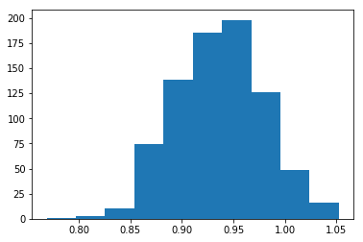
Modeling
Random forest
RMSE dist.
Mean = 0.937

Slide 22
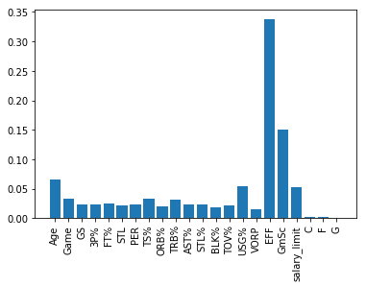
Modeling
Random forest
Feature Importance

Slide 23
Modeling
Linear regression vs Random forest
*Close performance
Possible Causes:
most useful features were derived from other features (so non-linearity already captured by formulaes)
features have nearly linear dependence on the salary. (so linear curve can have better approximation than RF (which is a composition of step functions) ) (also the R^2 in linear model already ~0.5 )
because of outliers, random forest can overfit

Slide 24
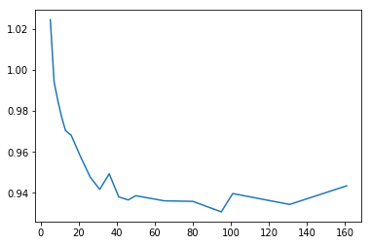
Modeling
Try to avoid overfitting (and see if we can do better than linear reg.)
Adjust number of tree

Slide 25
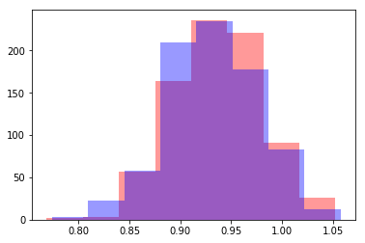
Modeling
increase minimum number of samples required to be at a leaf node.
RMSE 0.939 -> 0.932

Slide 26
Modeling
Without log-transformation
Linear regression's mean cv error: 4292244.2
Random forest without parameter tuning: 4035834.6
Random forest with parameter tuning: 4003055.7
(difference is statistically significant at 95% confidence level)

Slide 27
Modeling
Data Analysis
OLS(Ordinary Least Squares) for Multiple Regression Analysis
-> p-value <= 0.05

Slide 28
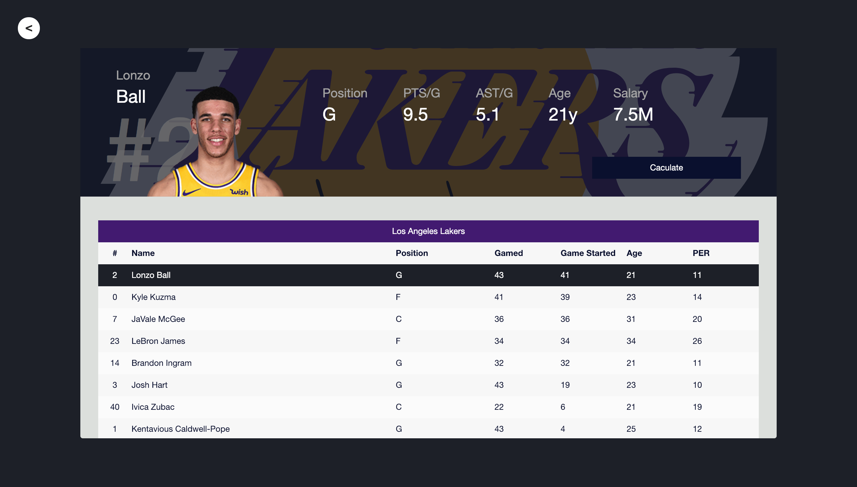
System Demo
Presentation Websites

Slide 29
System Demo
Presentation Websites
https://npsp.ms300k.com.tw

Slide 30
新增季後賽資料、球季獎項參考
不同Position分開處理
薪資規則考量(ex: 底薪條例、中產條例 etc)
Future Prospects

Slide 31
urllib.request
BeautifulSoup
pandas
numpy
matplotlib
seaborn
scikit-learn
xgboost
Packages

Slide 32
NBA Players Salary Projection
王瀚 徐躍華 林資超 徐子崴

